Slide 1
MILESTONE 4 · WEEKS 7–8
Mobility Equity & Executive
Intelligence Platform
Introduction
City transit agencies can see overall ridership, but not who is being left behind. Access to reliable transport is uneven across zones, and planners lack a single, forecast-aware view to prioritize where to act next. This platform brings equity scoring, demand forecasting, and executive decision support together in one place.
01

Slide 2
MILESTONE 4
Project Flow
Four stages carried this milestone from equity scoring through to a deployment-ready platform.
1
2
3
4
Equity Dashboard
Executive Dashboard
Forecasting & Anomaly Detection
Optimization & Deployment
Implement the Mobility Access Index and build zone-level equity dashboards.
Roll up KPIs into a single leadership-facing intelligence view.
Add demand forecasting and automated anomaly alerts to the trip data.
Optimize dashboard performance and complete deployment readiness.
02

Slide 3
FOUNDATION
Dataset Overview
Trip-level mobility data covering one month across the city, joined with zone, weather, and demographic context.
Time Period
Zones Covered
Transport Modes
01 May 2024 – 31 May 2024
Daily trip records
Dwaraka Nagar, Seethammadhara, MVP Colony, Gajuwaka, Madurawada, Rushikonda, Pendurthi
Cab, Bike, Bus, Auto
Weather Conditions
Core Metrics
Segments
Clear, Cloudy, Heavy Rain, Light Rain
Total Trips, Avg Travel Time, Mobility Access Score, Service Coverage
Demographic Group, Zone, Transport Mode filters
03

Slide 4
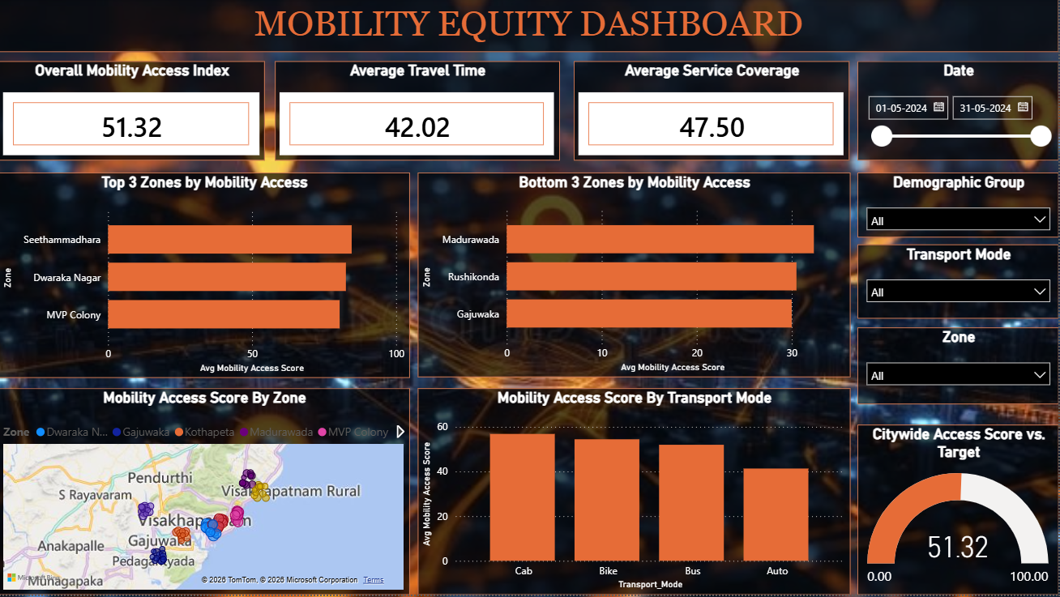
DASHBOARD 01
Mobility Equity Dashboard
04

Slide 5
DASHBOARD 01 · Q&A
Mobility Equity — Questions & Answers
1
Which areas have the highest mobility access?
Seethammadhara has the highest access, followed by Dwaraka Nagar and MVP Colony.
2
Which areas have the lowest mobility access?
Gajuwaka has the lowest access, followed by Rushikonda and Madurawada.
3
Which areas appear underserved?
Gajuwaka, Rushikonda, and Madurawada — all three carry very low mobility scores.
4
What factors contribute to low accessibility?
Mainly low service coverage (47.50), high travel time, and poor auto service in outer zones like Madurawada and Gajuwaka.
5
What can the city do to improve access?
Add transit routes and increase vehicle frequency — Gajuwaka first, then Rushikonda and Madurawada — prioritizing by riders gained per added route.
05

Slide 6
DASHBOARD 01 · INSIGHTS
Key Insights & Recommendations
KEY INSIGHT
RECOMMENDATION
Access is unevenly distributed: Seethammadhara, Dwaraka Nagar, and MVP Colony lead, while Gajuwaka, Rushikonda, and Madurawada trail far behind the citywide average of 51.32.
Low accessibility in these zones traces back to low service coverage (47.50), high average travel time, and weak auto/feeder connectivity in outer areas.
Add transit routes and raise vehicle frequency in Gajuwaka first — lowest score, largest underserved population.
Follow with Rushikonda and Madurawada.
Prioritize rollout by which zone gains the most riders per added route.
06

Slide 7
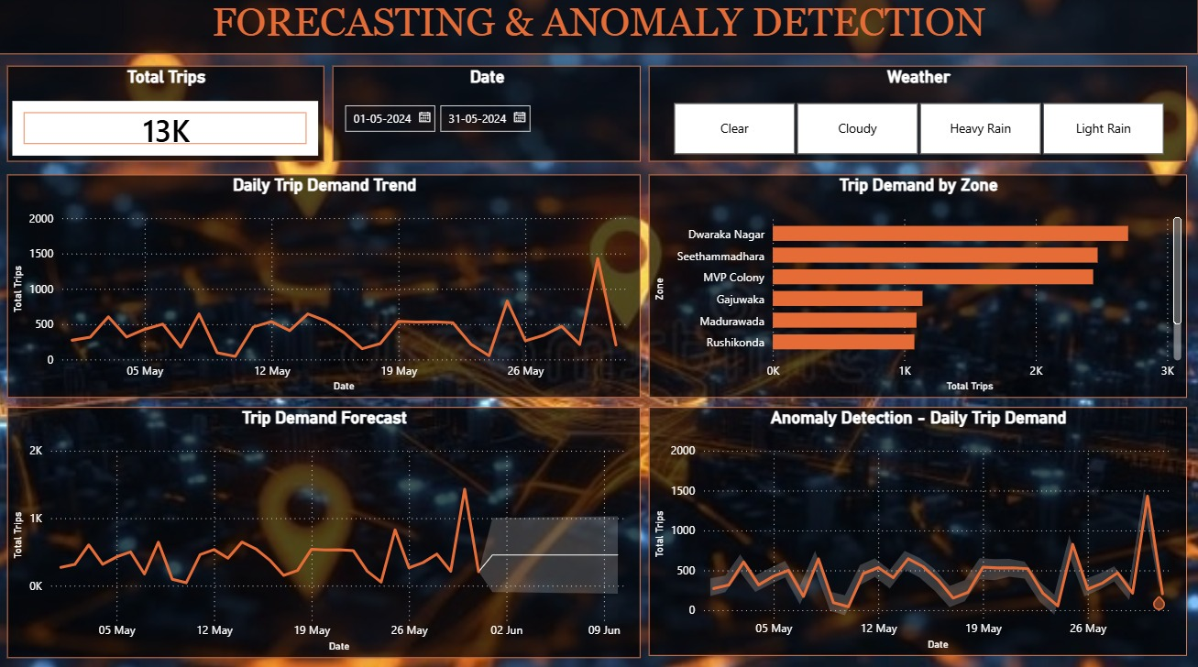
DASHBOARD 02
Forecasting & Anomaly Detection Dashboard
07

Slide 8
DASHBOARD 02 · Q&A
Forecasting — Questions & Answers
Q1. What are the unusual points in the demand trend, and when did they occur?
May 30, 2024 — a sharp demand spike to roughly 1,900 trips against a daily average of 600–700, the highest point on the chart.
May 10, 2024, Pendurthi — a dip with Mobility Access Score at 0.18 and travel time up to 62 minutes, well outside the normal range.
Q2. What factors might explain each anomaly, and what would you recommend?
May 30 spike — clear weather combined with higher-than-usual activity at month-end. Recommend keeping extra vehicles on standby for similar days.
May 10 Pendurthi dip — heavy rain, and only 8 transit routes to begin with. Recommend weather-resilient transit (covered stops, backup vehicles) in low-route zones first.
08

Slide 9
DASHBOARD 02 · INSIGHTS
Key Insights & Recommendations
May 30 spike
Likely combined with higher-than-usual travel activity across multiple zones at month-end.
→ Keep extra vehicles on standby for similar high-activity, clear-weather days.
Clear weather
May 10 Pendurthi dip
Pendurthi has only 8 transit routes to begin with, leaving little buffer when service was disrupted.
→ Prioritize weather-resilient transit — covered stops, backup vehicles — in low-route zones like Pendurthi first.
Heavy rain
09

Slide 10
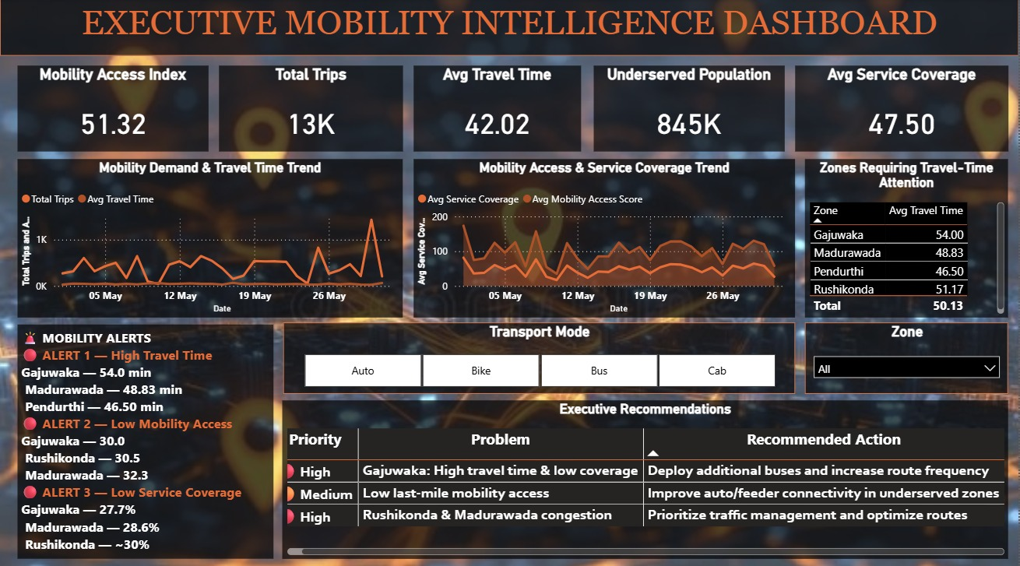
DASHBOARD 03
Executive Mobility Intelligence Dashboard
10

Slide 11
DASHBOARD 03 · INSIGHTS
Executive Insights & Recommendations
MOBILITY ALERTS
EXECUTIVE RECOMMENDATIONS
High travel time
High
Gajuwaka 54.0 min · Madurawada 48.8 min · Pendurthi 46.5 min
Gajuwaka — high travel time & low coverage
Low mobility access
Deploy additional buses and increase route frequency.
Gajuwaka 30.0 · Rushikonda 30.5 · Madurawada 32.3
Medium
Low service coverage
Low last-mile mobility access
Gajuwaka 27.7% · Madurawada 28.6% · Rushikonda ~30%
Improve auto/feeder connectivity in underserved zones.
High
845K
residents underserved citywide
Rushikonda & Madurawada congestion
Prioritize traffic management and optimize routes.
11

Slide 12
MILESTONE 4
Conclusion
Milestone 4 delivered a complete, three-dashboard mobility intelligence platform — from raw trip data to executive decision support.
✓
Mobility Equity Dashboard scoring every zone against a citywide access index of 51.32
✓
Forecasting & Anomaly Detection dashboard flagging demand spikes and service dips in near real time
✓
Executive Mobility Intelligence Dashboard consolidating alerts and recommendations for leadership
✓
845K underserved residents identified, with a prioritized, data-backed action plan for Gajuwaka, Rushikonda, Madurawada, and Pendurthi
Milestone 4 status:
Complete — all three dashboards deployed and validated
12

Slide 13
Thank You
Mobility Equity & Executive Intelligence Platform
13

